Slide 1

Academic Advisor (A-Square)
Team member:
Szeto Sai Kit (SK)
Hsieh Man Yee (Money)
Wong Krit (Chris)
Ho Cheuk Hei (Brian)
Tang Kwong Lun (Alan)

Slide 2
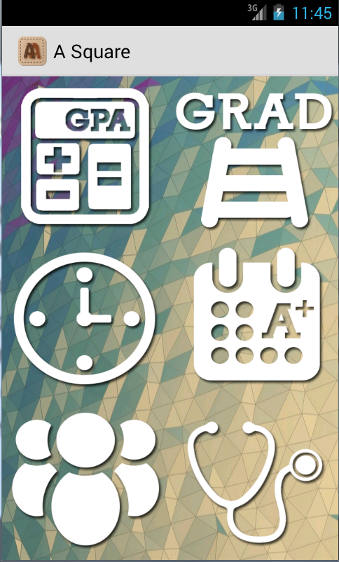
Main page
Simple and user friendly
Six functions:
GPA Calculator
Advisory Study Path
Exam Count-down
Study Time Advice
Chat Room
Psychological advising

Slide 3
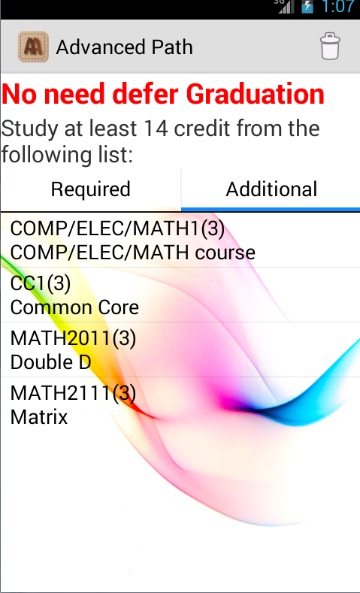
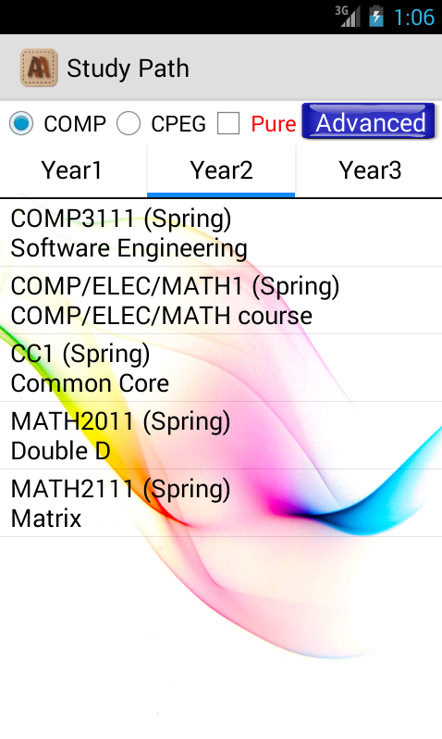
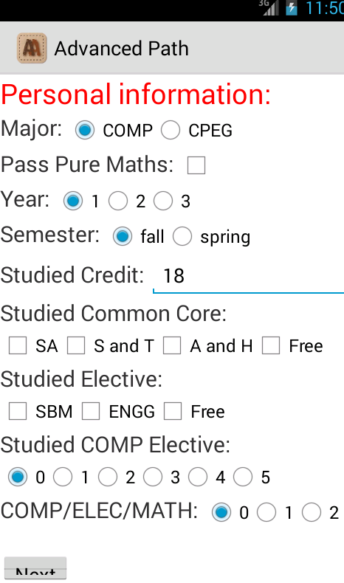
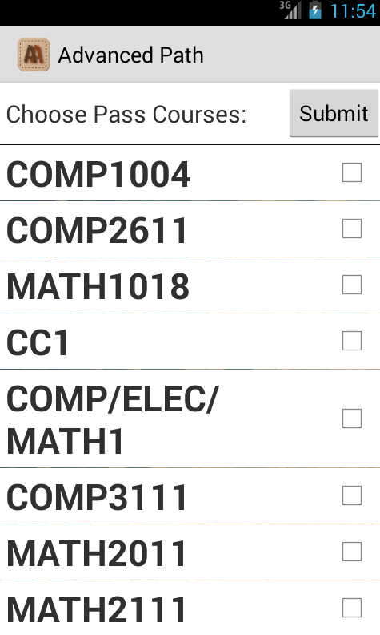
Functions Achieved
Advisory Study Path
Recommended one
COMP & CPEG Students
Studied Pure Maths or not
Advanced one
Input information
Choose Passed Courses
Generate automatically
Output
Credit needed next Semester
Required : Must add
Additional : Suggestion
Next

Slide 4
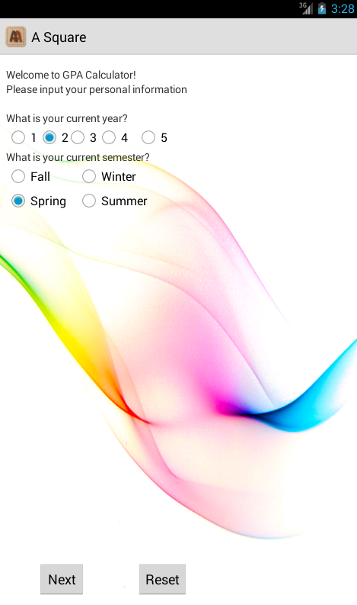
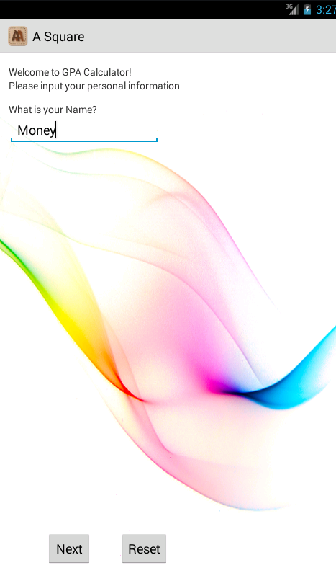
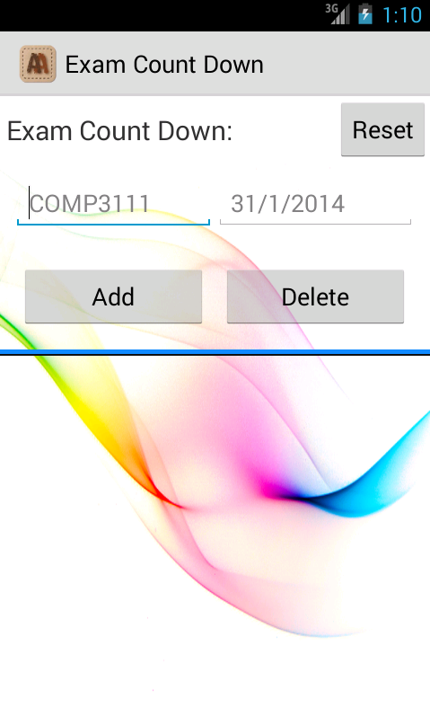
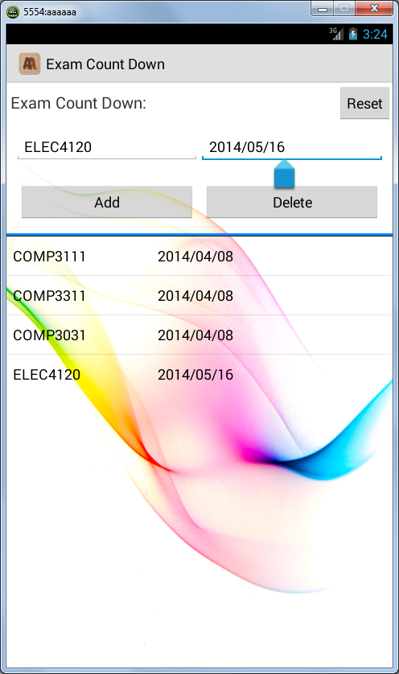
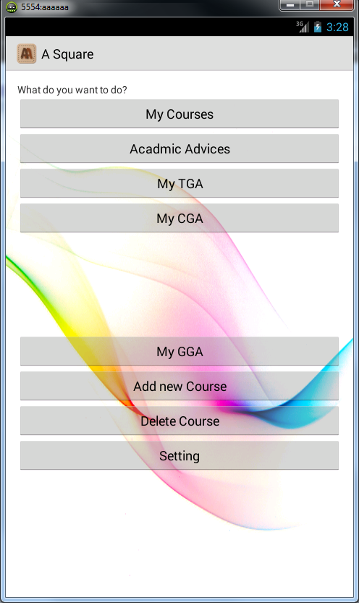
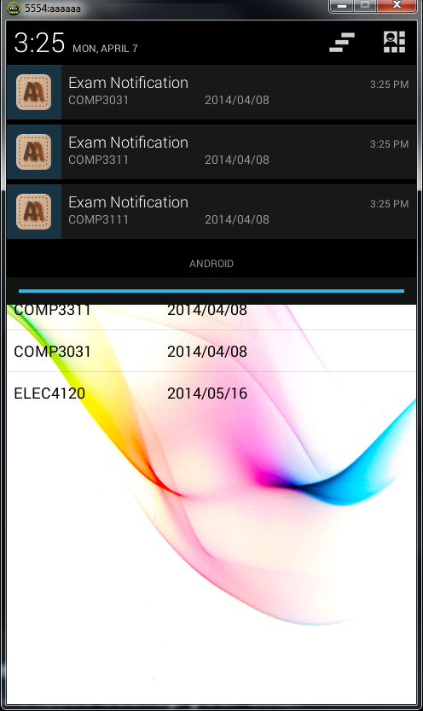
Function Achieved
Exam Count Down
Add Course
Notifications
GPA Calculator
Input data
Generate GPA

Slide 5
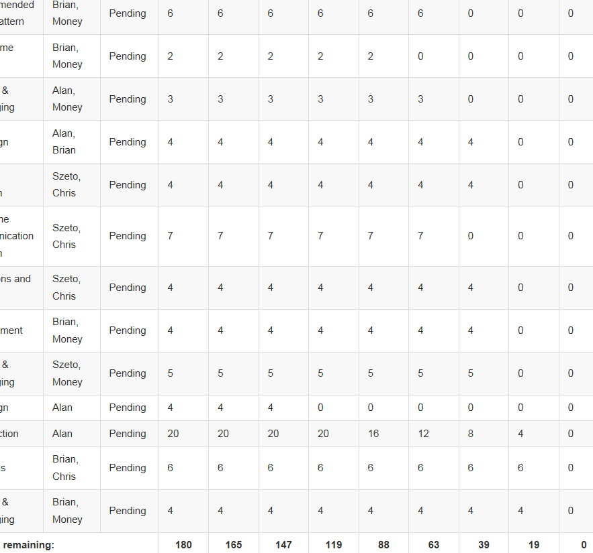
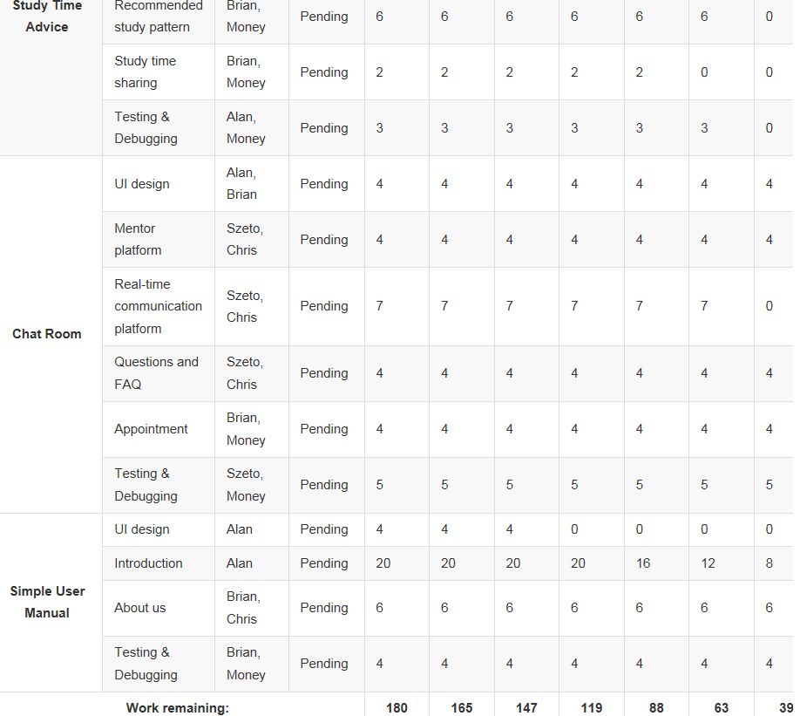
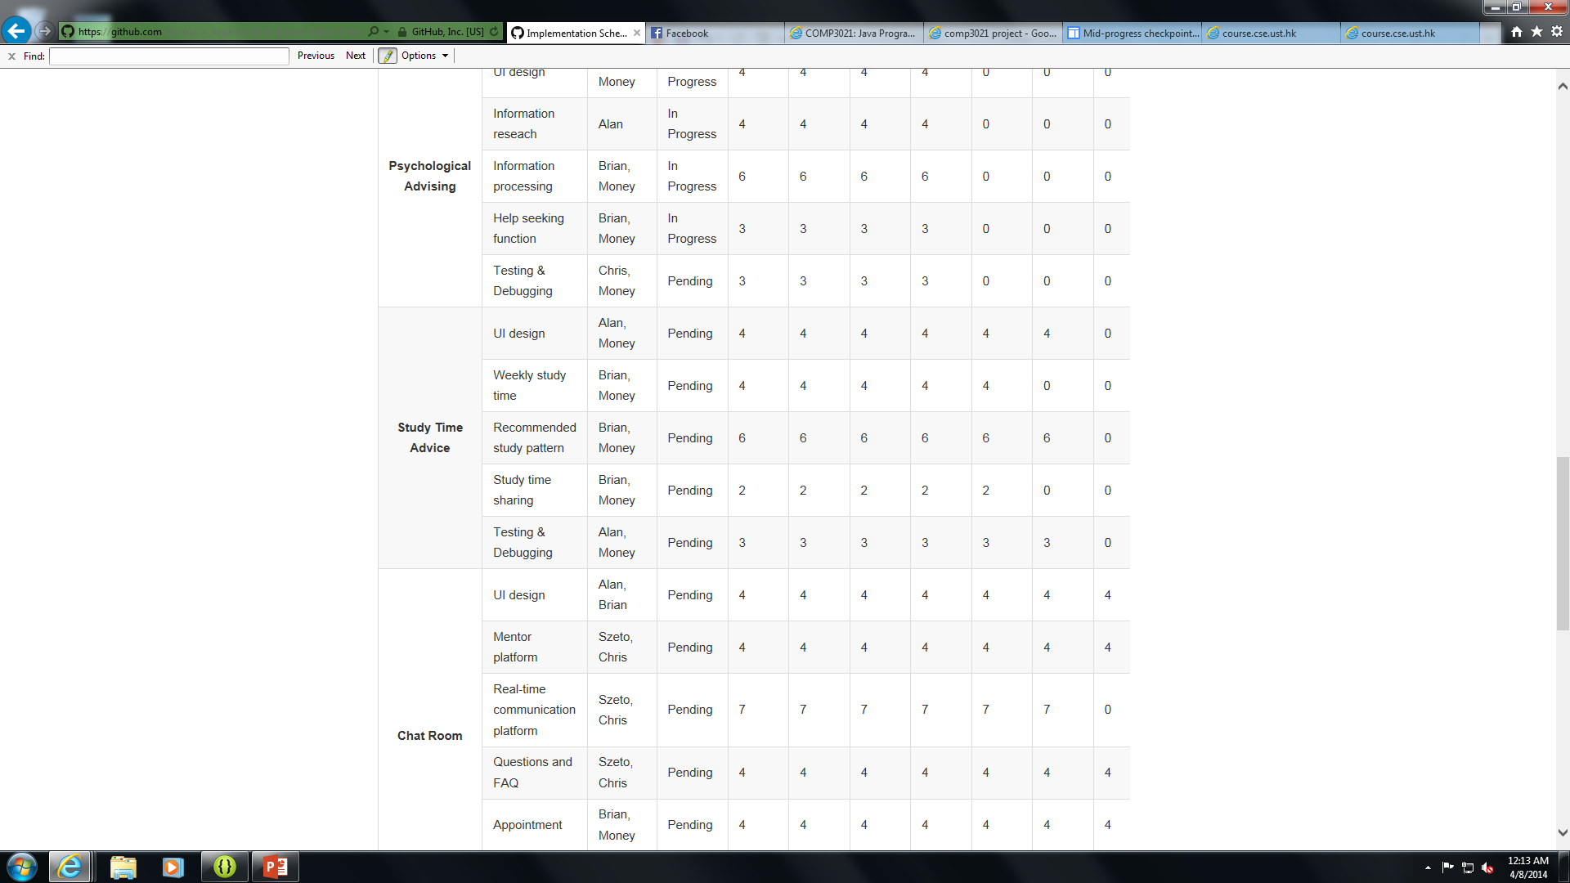
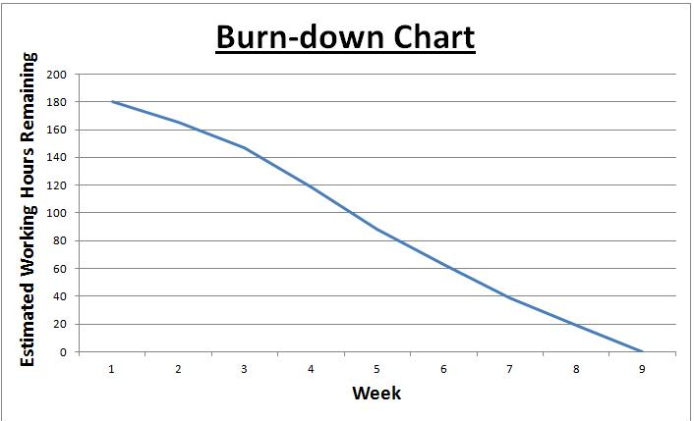
In progress
Start from 3/3
Week 6
Proposed to Finish all in Week 9
Study Time Advice : Study schedules planning
Chat Room : Advise from mentors
Psychological Advising : Emergency needed
Challenges
Unfamiliar with the Android Developing process
Time management
Workload from other midterms and assignments
Make a high quality application for UST students

